Slide 1
Contrastive learning of salient features
Input data: Background (BG) and Salient (SL) images
BG image (IMAGENET)
Sample representation
Sample representation
SL image (IMAGENET+MNIST)
Background space
Salient space
Network Architecture
Image input
Axis 2 (a.u.)
Axis 2 (a.u.)
Conv.
Encoders
Conv.
Encoders
Axis 1 (a.u.)
Axis 1 (a.u.)
Dim. reduction (UMAP)
Background feature space
Salient feature space
Shared decoder
Image reconstruction
GMM clustering
Data flow
Salient features learned from overlapping (BG+SL) images
BG images reconstructed using BG features
Cluster prototypes
SL images reconstructed using BG + SL features

Slide 2
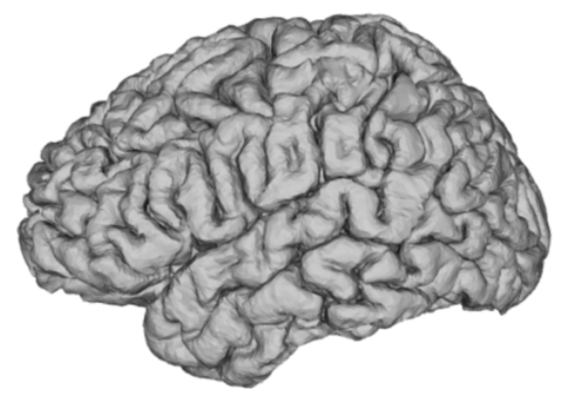
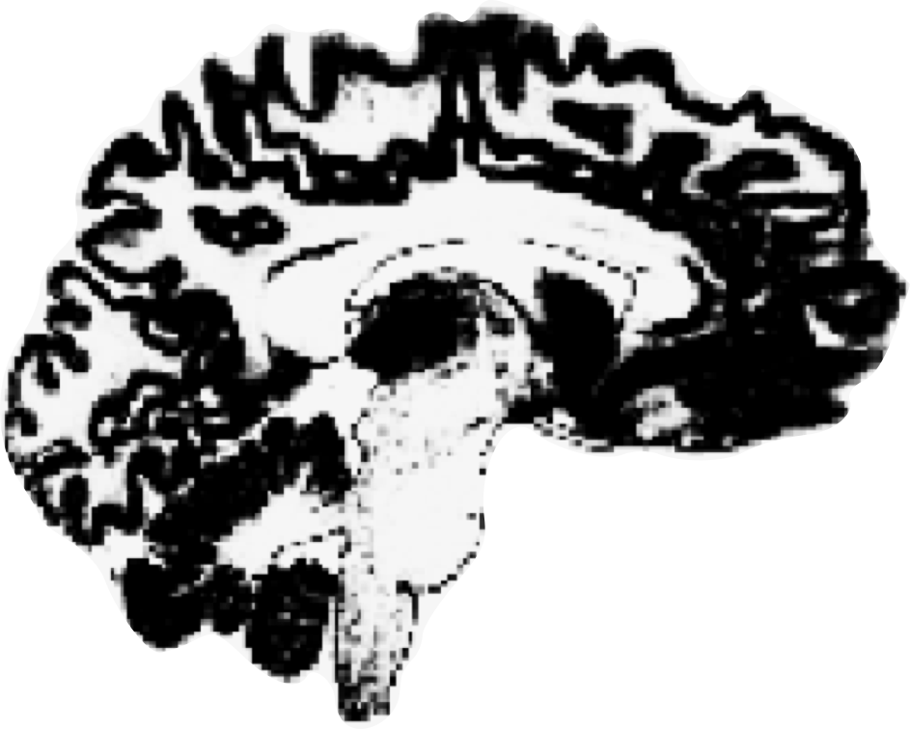
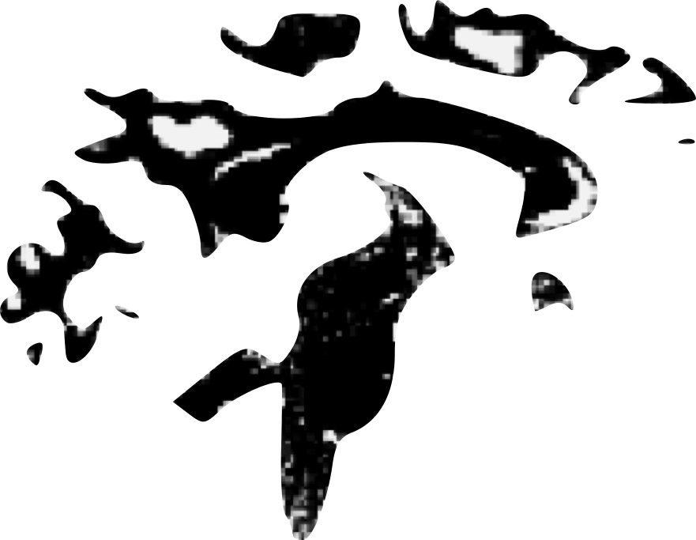
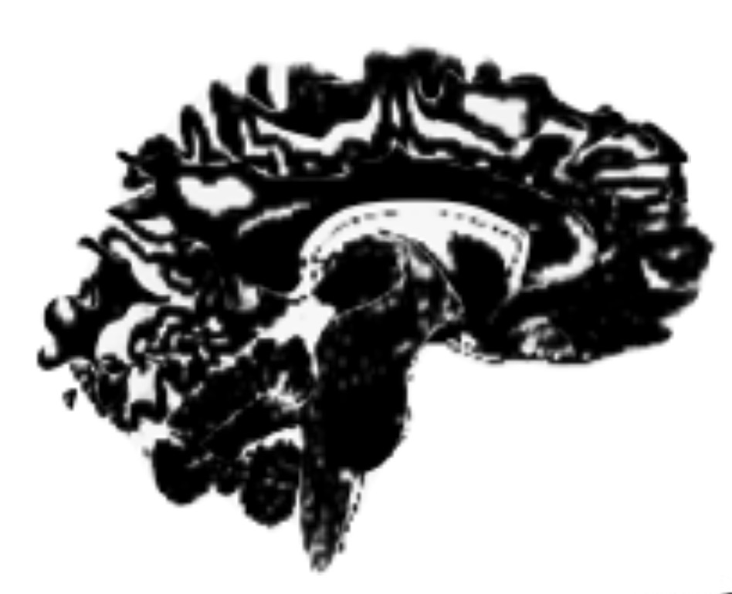
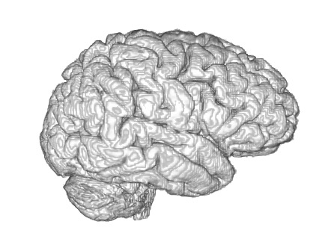
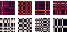
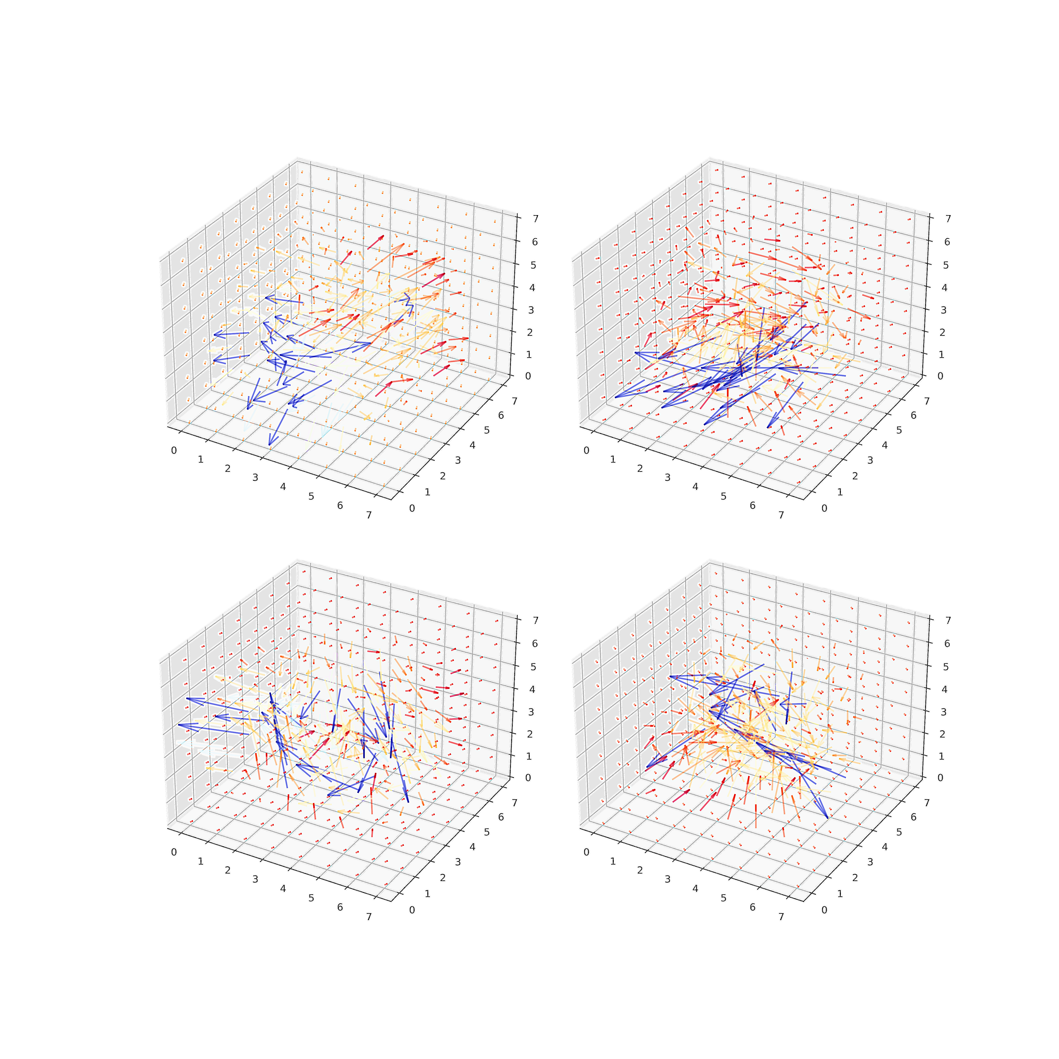
Data Preprocessing
Contrastive autoencoding
RSA analyses
Neuroanatomical
Analyses
T1w image in native space
Data path for TD input
Data path for ASD input
ASD data input (N=470)
ASD brain
ASD brain
Tissue segmentation
𝝁_{j}
𝞼_{j}
𝝁_{k}
𝞼_{k}
𝝁_{j}
𝞼_{j}
0
0
Gray Matter
White Matter
Extract subject similarity
+
BG space
SL space
Full reconstruction
Reconstruction of TD features only
Subjects
Subjects
Brain
Tissue
TD reconstruction
ASD reconstruction
Subjects
Subjects
Identification of ASD features
RSA models
ASD brain
TD features
Subject’s brain in Native space
(3D Volumetric view)
Convolutional
encoders
Shared decoder
=
+
Salient space
Background space
Spatial normalization TD -> ASD
𝝁_{k}
𝞼_{k}
𝝁_{j}
𝞼_{j}

Slide 3
RSA analyses
ABIDE
SFARI

Slide 4
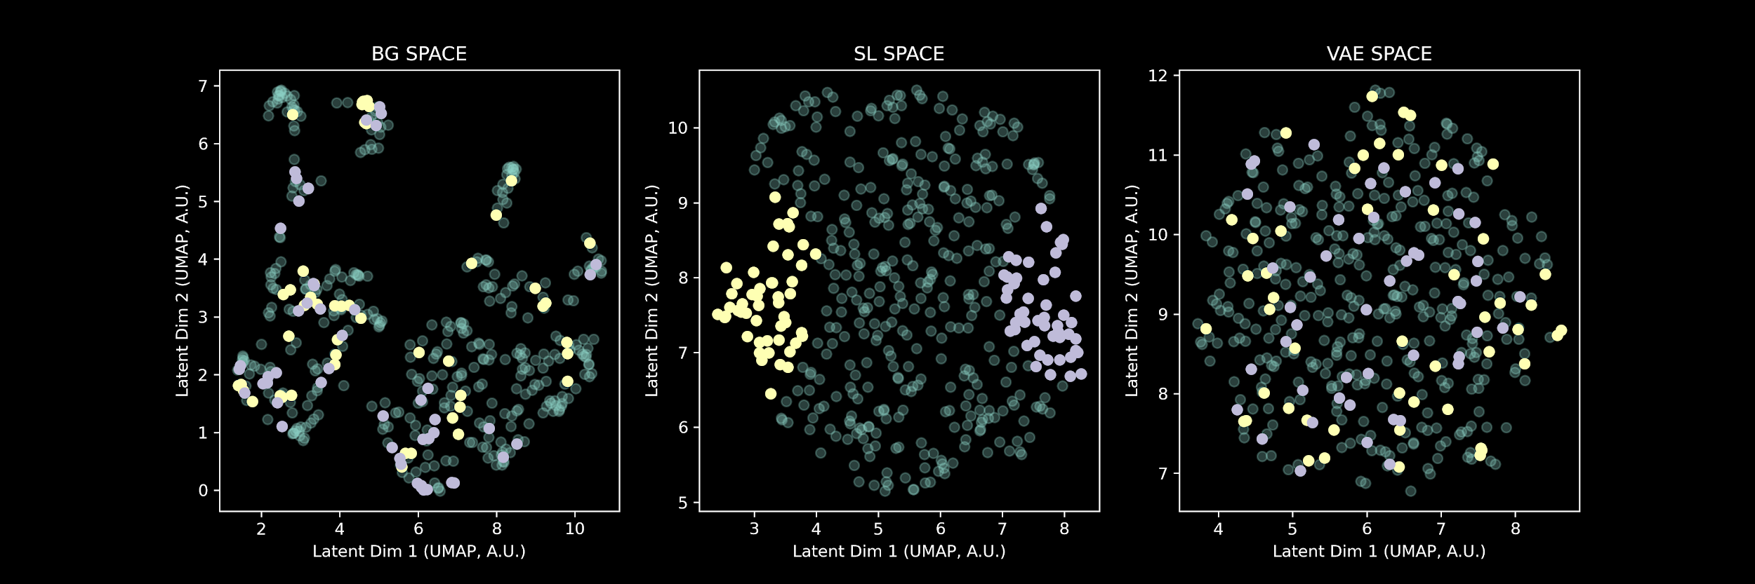
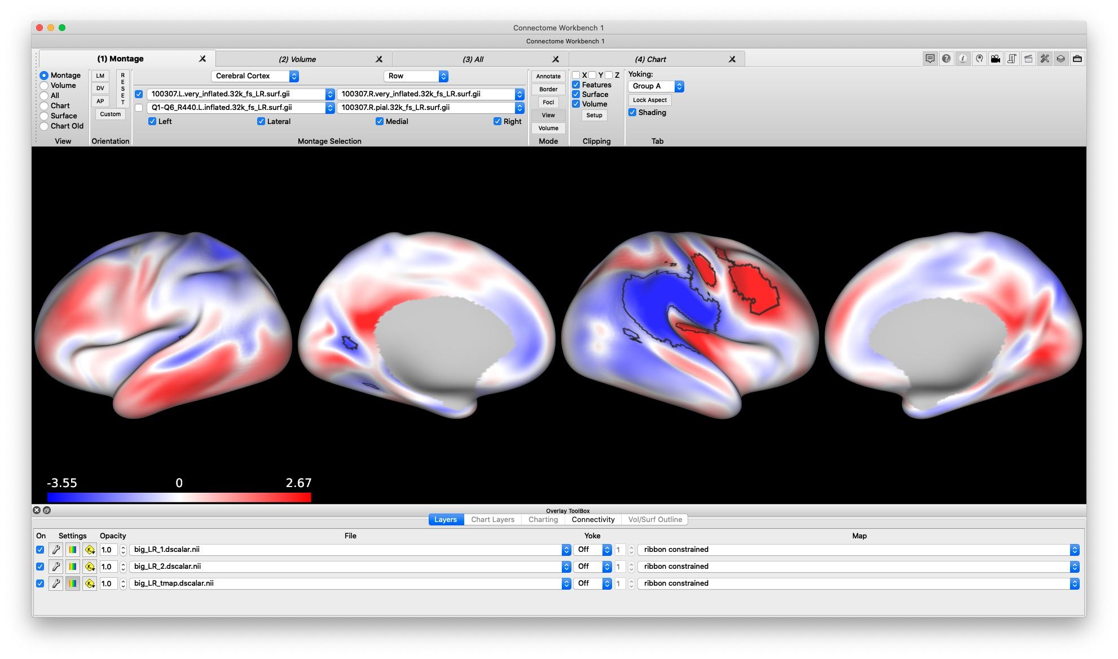
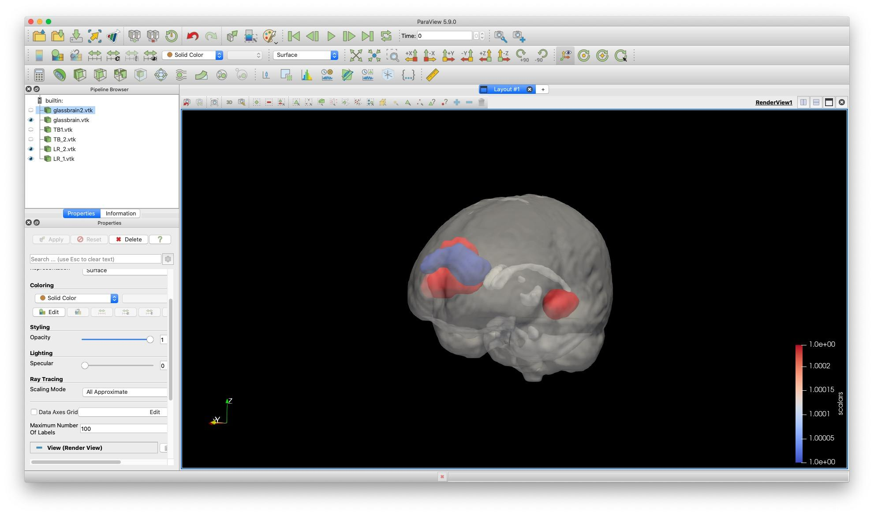
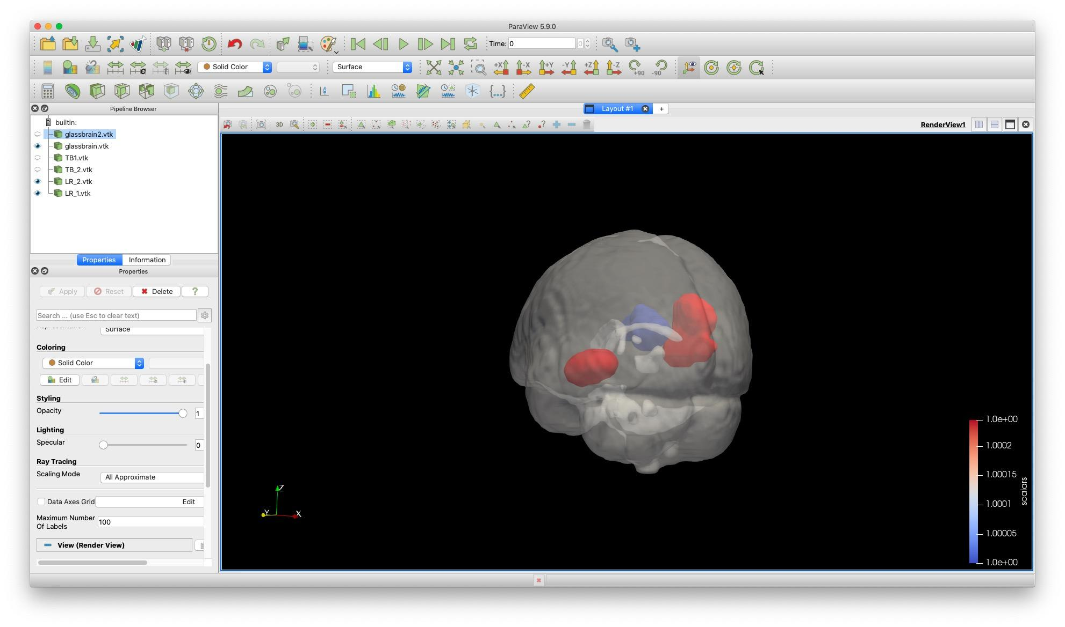
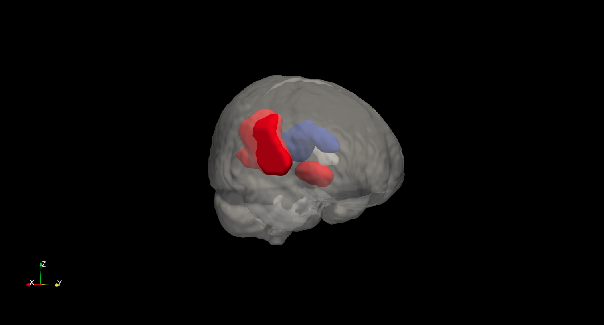
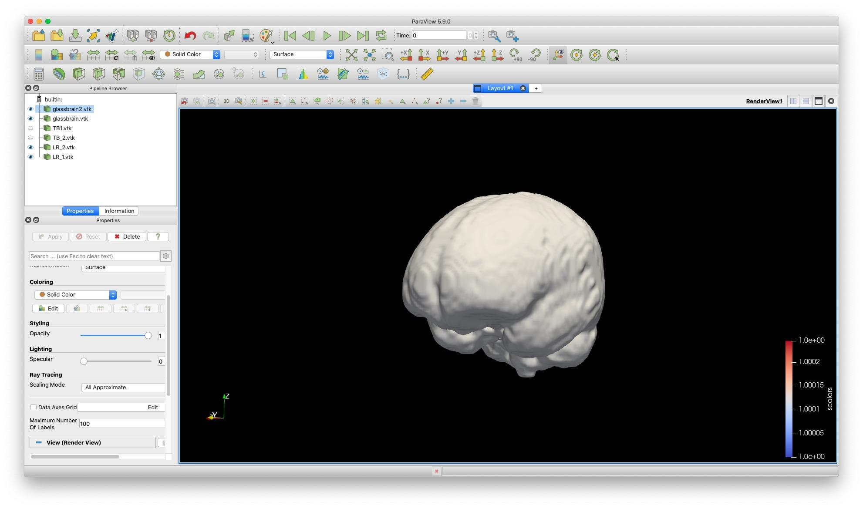
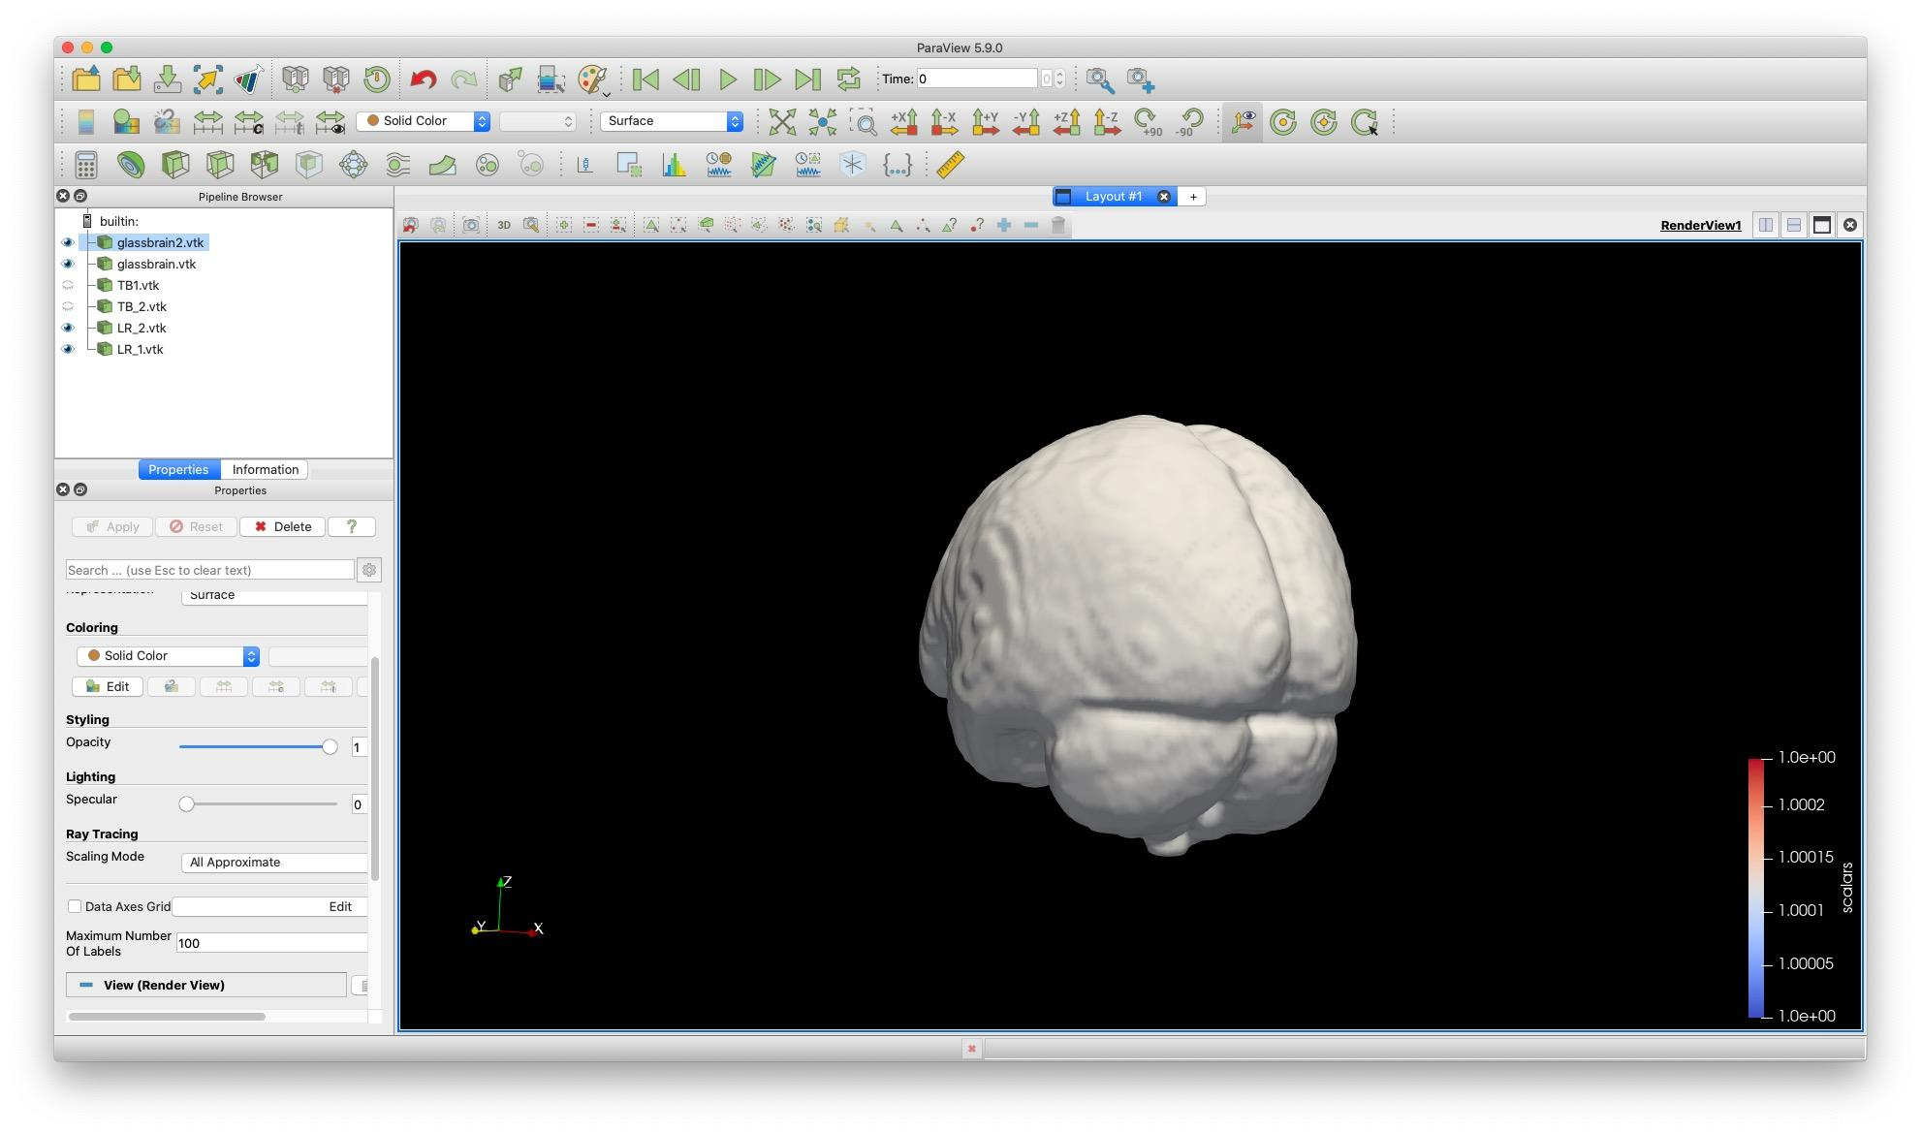
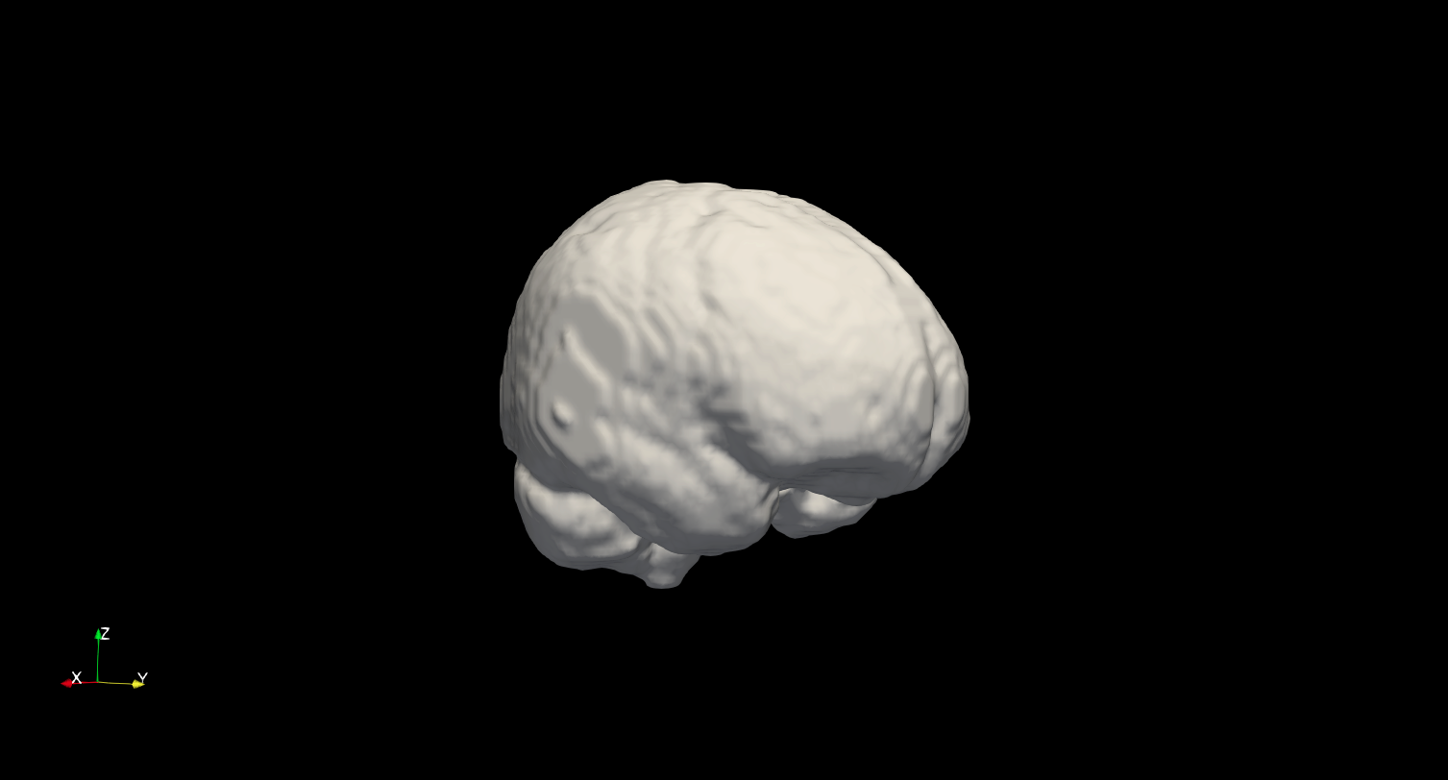
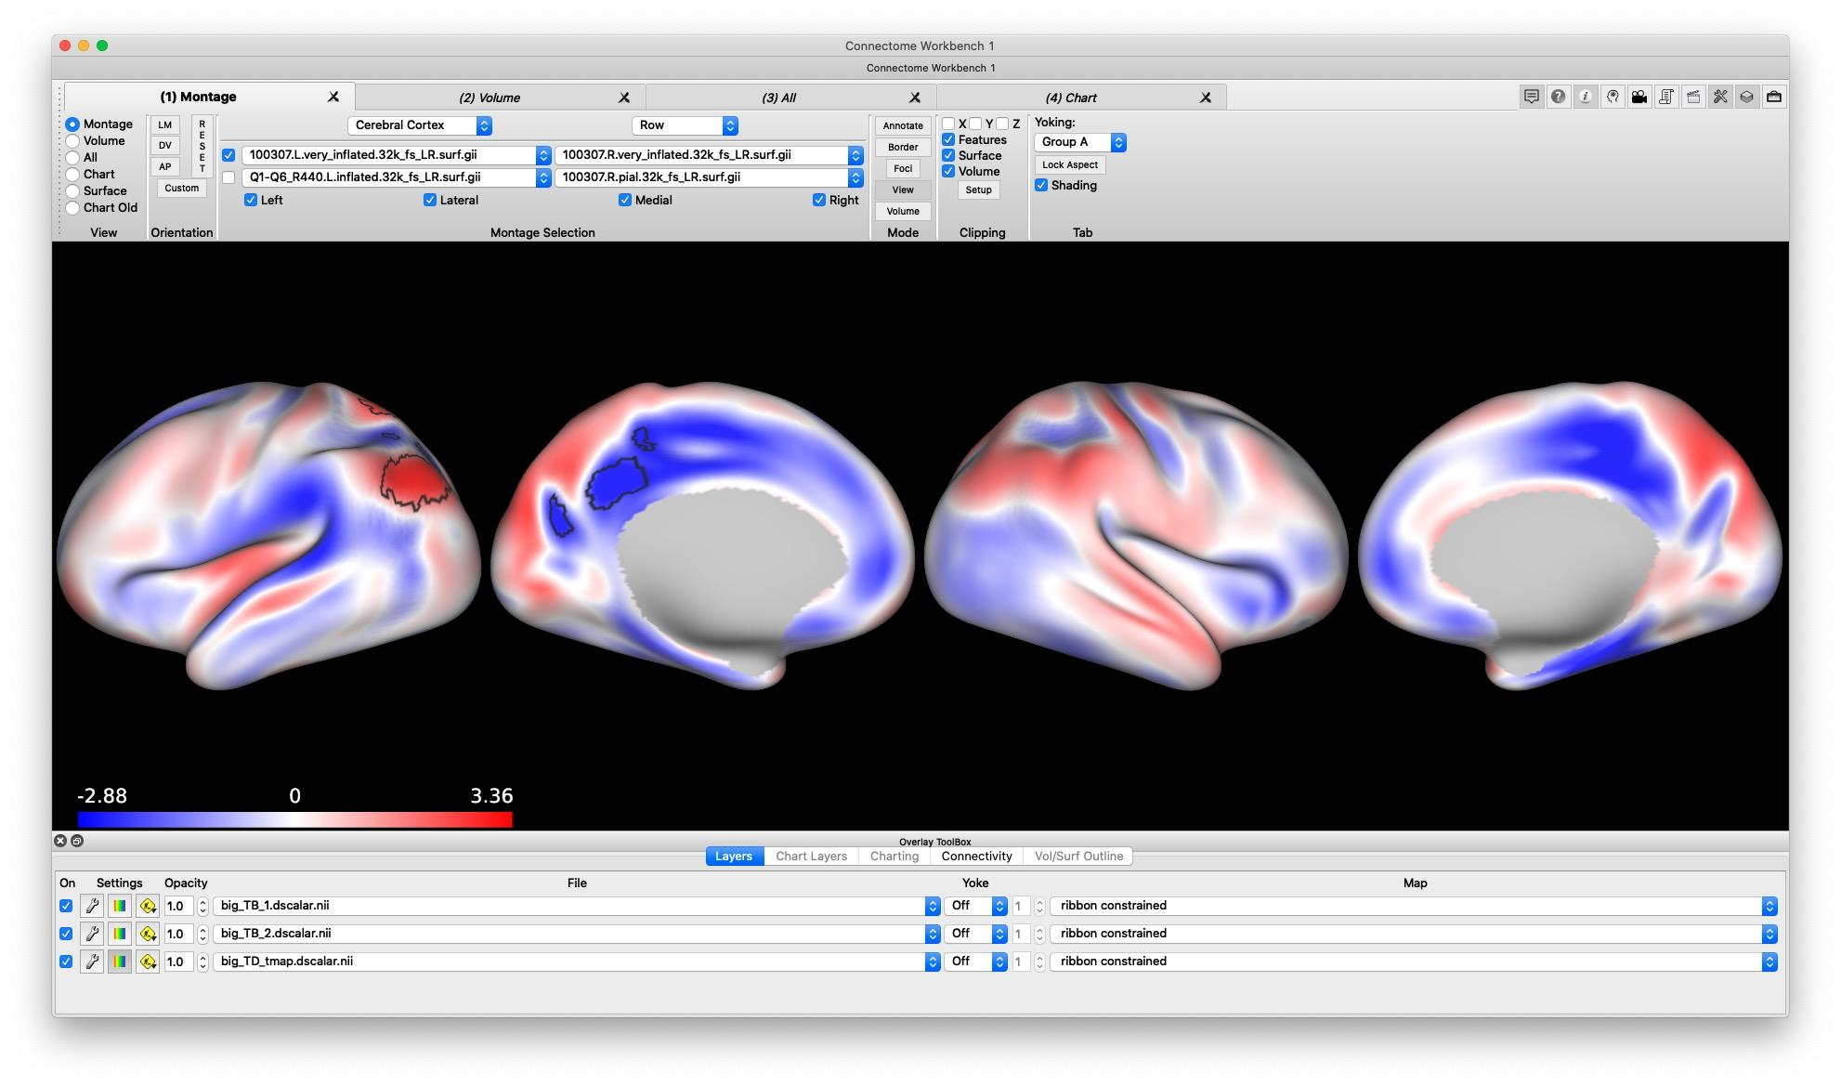

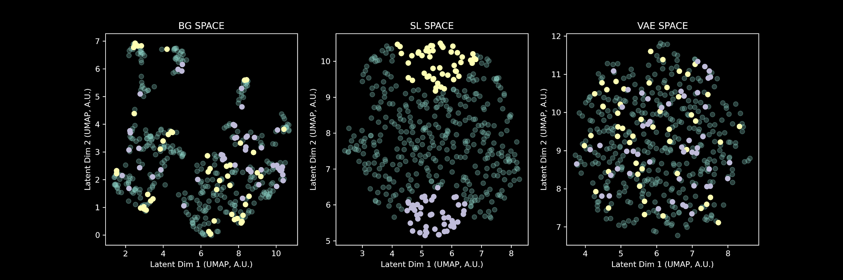
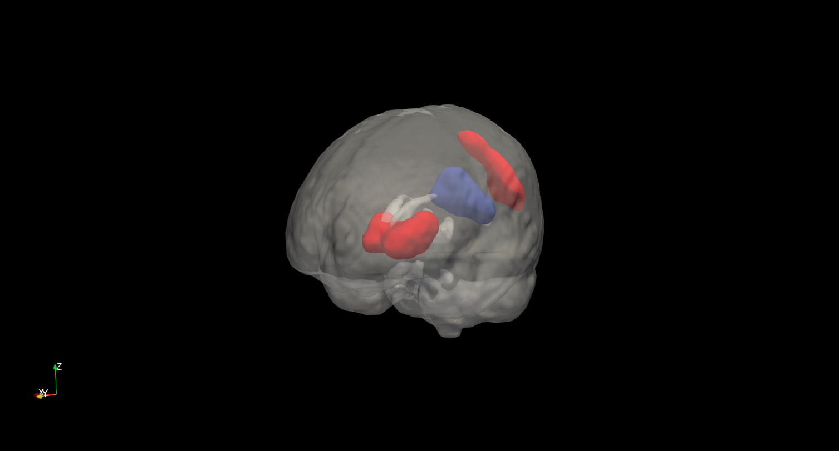
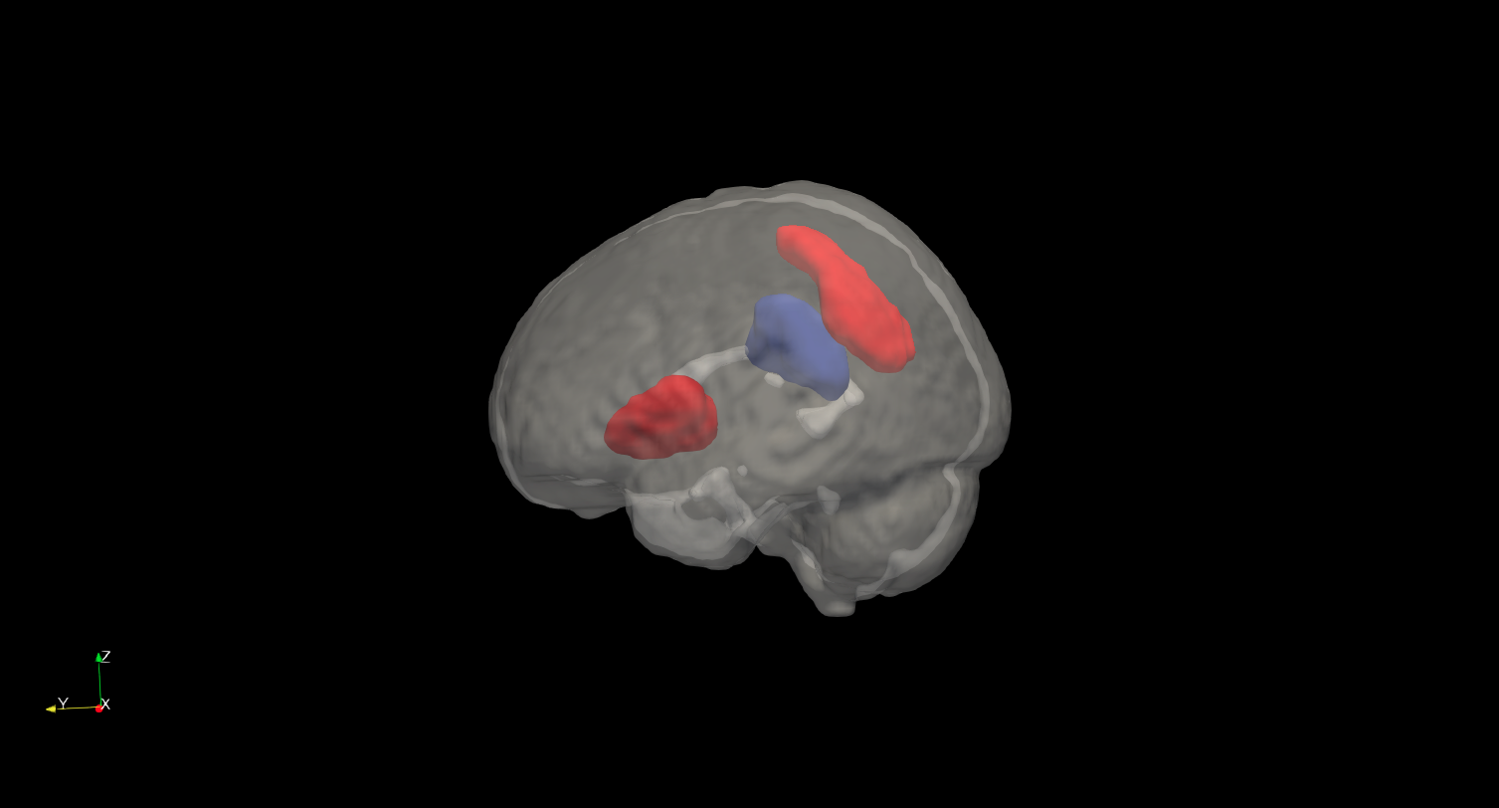
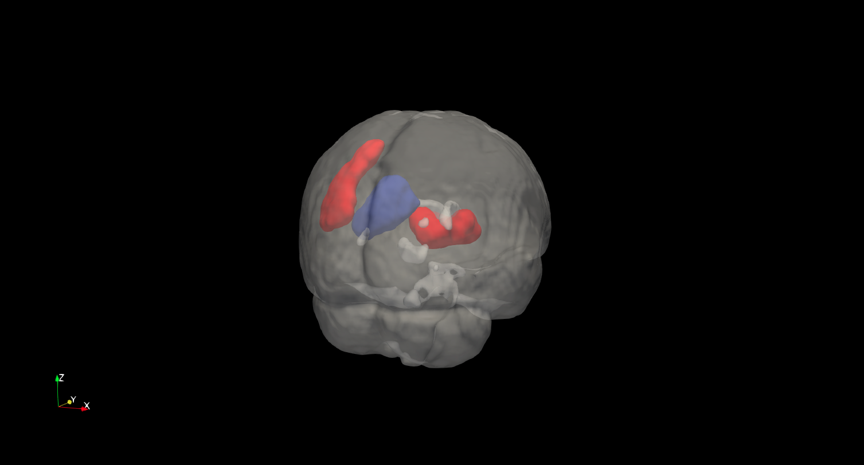
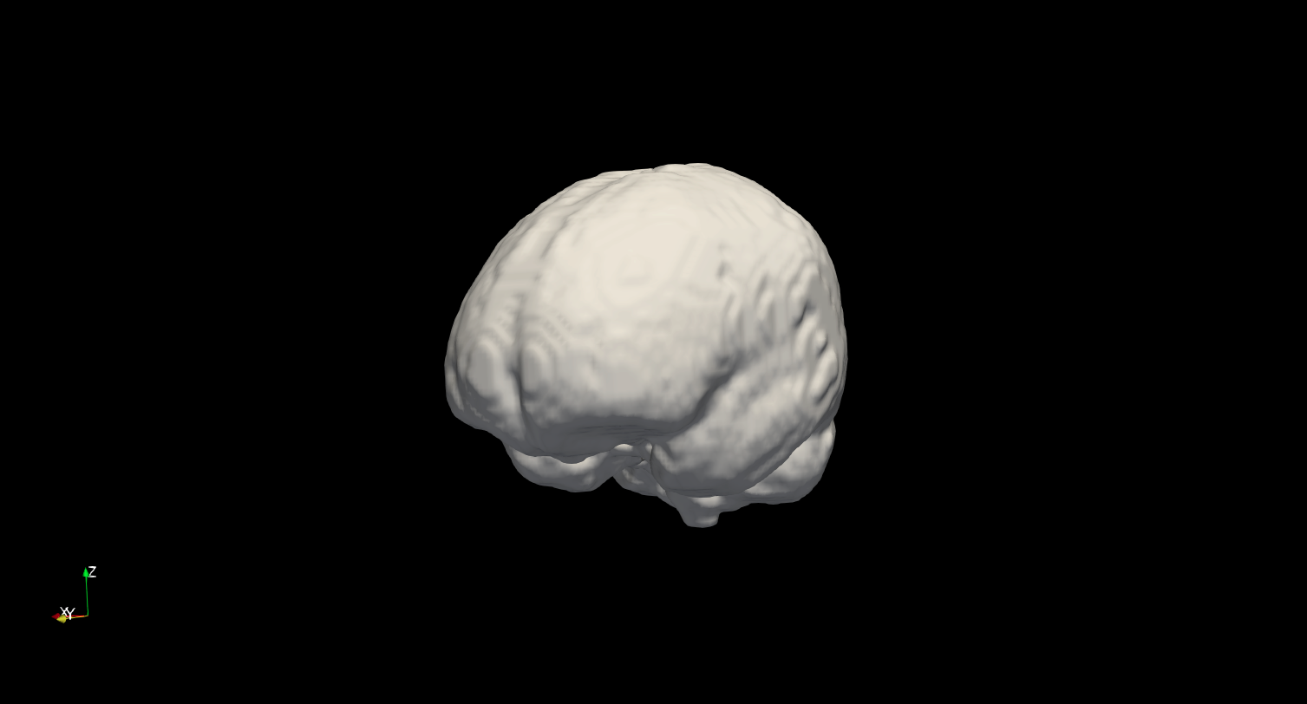
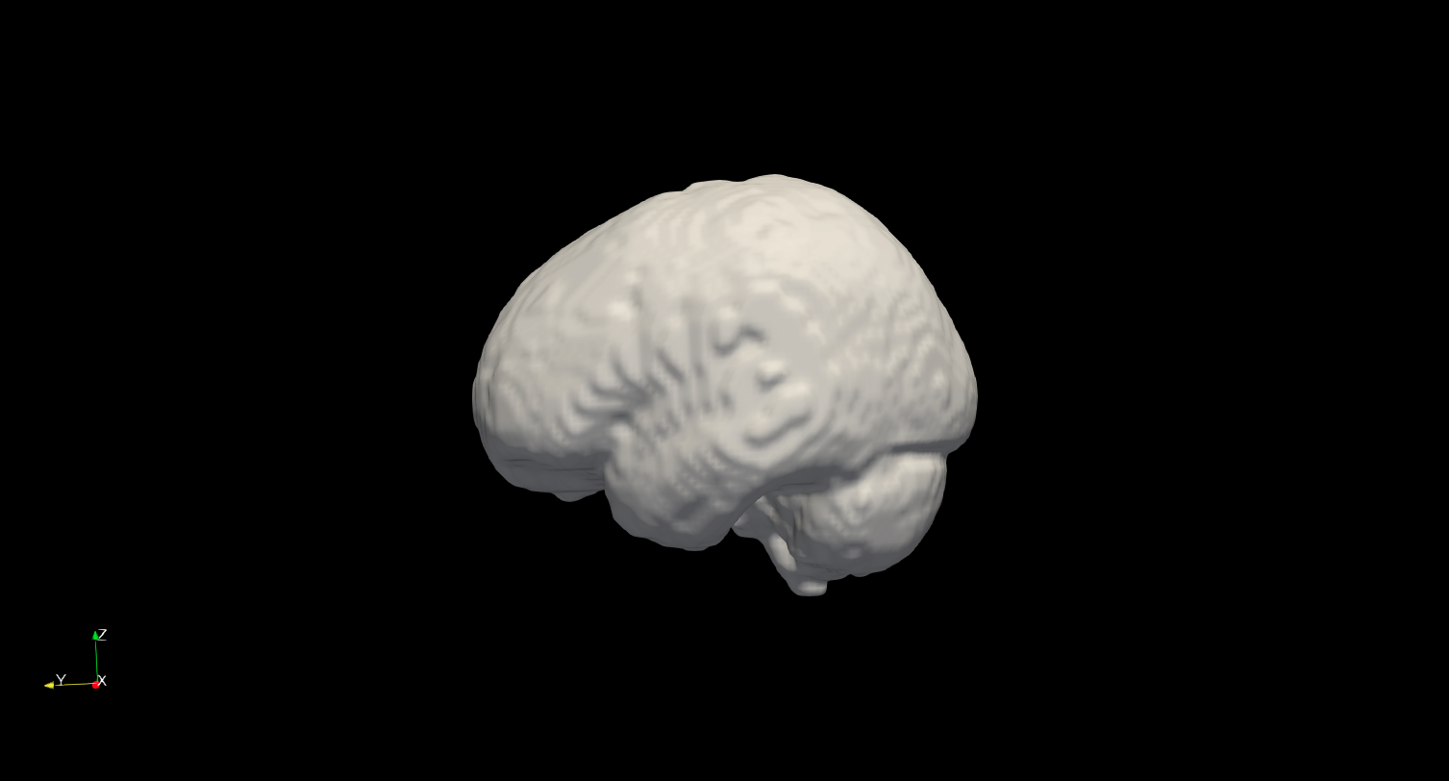
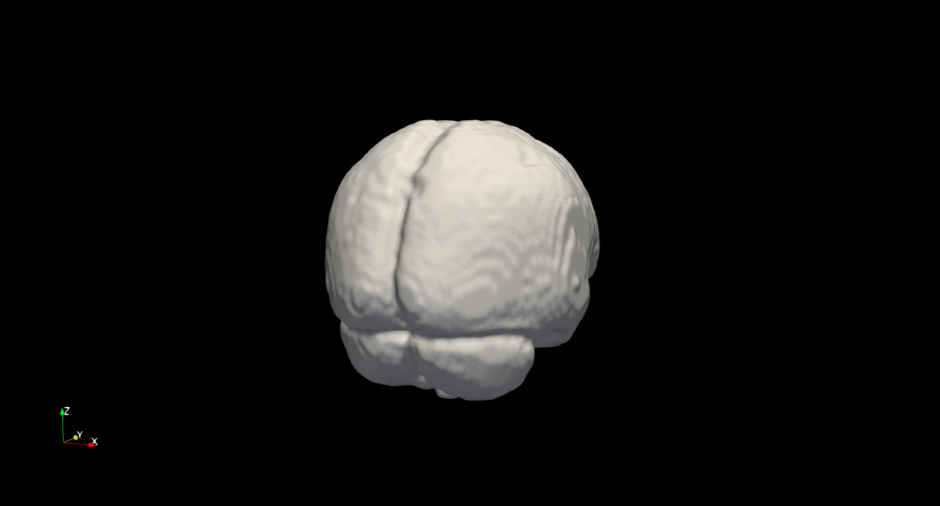
t-comparison Axis
Cortical View
Volumetric View
Expansion / compression. Cluster p < .05 (FWE)
Left vs Right
-4.66
t-value
4.2
Orientation guide
0
Cluster p < .05 (FWE)
Top vs Bottom
Expansion / compression. Cluster p < .05 (FWE)
t-value
4.74
Cluster p < .05 (FWE)
Orientation guide
-3.65
0
0

